Slide 1



CyberShield AI
AI-BasedCyber Security Threats Prediction Platform
Real-time, Immersive, & Command-Driven Threat Monitoring
Secure Connection
AI-Powered Protection
Real-time Analysis
Notes:
1

Slide 2









The Challenge:
The Need for Immersive, Actionable Intelligence
Security teams face a constant, high-velocity stream of sophisticated cyber threats, making manual analysis impractical.
Passive Monitoring
Information Overload
Complex Tool Interaction
Analysts are often stuck passively viewing static dashboards, which is too slow to combat zero-day exploits and Advanced Persistent Threats (APTs).
overwhelming volume of data from 30+ global locations and multiple threat types.
Rapid threat response is hindered by traditional, click-driven interfaces that force analysts to take their hands off the keyboard.
Security Alert Overload
Need: An AI-powered unified platform to transform chaos into actionable intelligence
2 / 12
Notes:
2

Slide 3
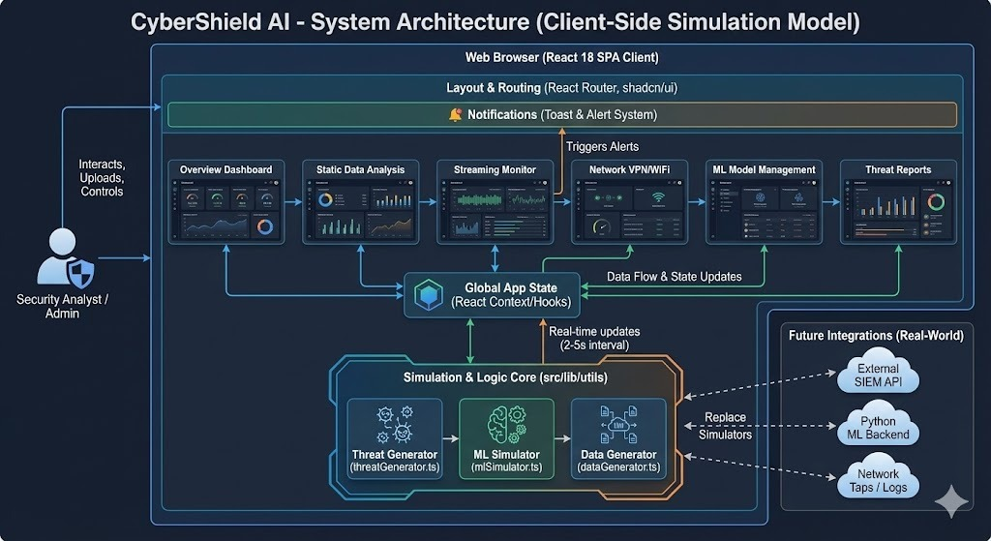








Our Solution:
A Unified, Intelligent Platform
Dashboard
ML-Powered Prediction
⌨️ Command Palette
A centralized " Cyber Threat Dashboard" provides a single pane of glass for all security events, showing blocked attacks and critical alerts.
Leverages Machine Learning (Random Forest) to predict and classify threats automatically, enabling proactive defense.
A keyboard-driven power tool for instant navigation and quick actions across the platform.
Outcome: Empowers analysts to move from reactive defense to proactive threat hunting
3 / 12
Notes:
3

Slide 4







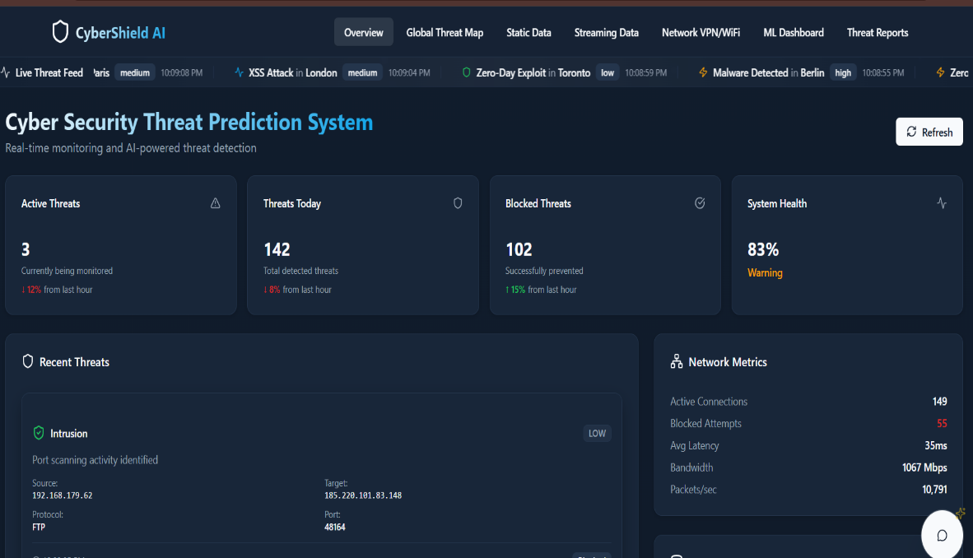
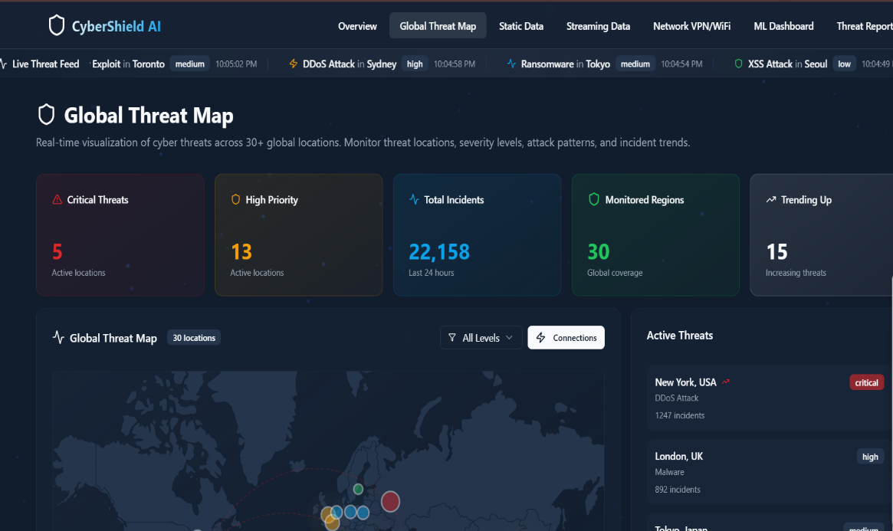
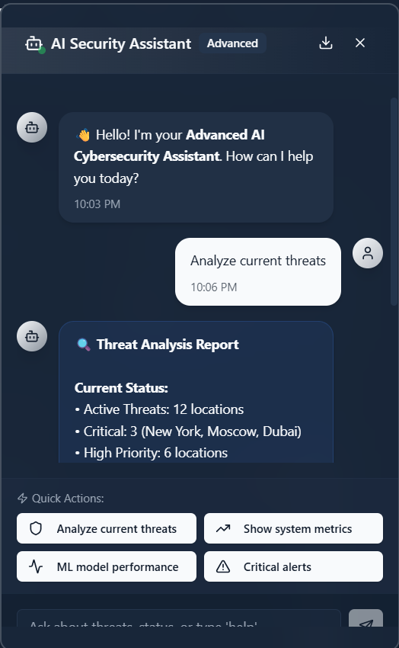

Key Feature:
Live Dashboard & AI Core
A unified platform providing real-time insights and AI-powered analysis.
Unified Dashboard
Live Event Feeds
AI Chatbot
At-a-glance metrics for security events with live-updating charts.
Auto-refreshing tables for real-time threat intelligence.
Conversational AI that understands dashboard context for quick insights.
Key Benefit: Transform complex security data into actionable intelligence
4 / 12
Notes:
4

Slide 5


















Key Feature:
Analysis & ML Training
Advanced analysis tools transform raw security data into actionable intelligence.
Monitor Website
Offline Dataset Analysis
Clear, Actionable Steps
Test security weaknesses of specific API endpoints or live websites.
Upload historical log files for comprehensive analysis with geo-threat mapping.
Provides a prioritized action plan to help users fix detected vulnerabilities.
Example file:
threat_data.csv
Example:
86%
Model:
Action Plan
MEDIUM risk
....
Loading
Data Collection
Analysis
ML Training
Enhanced Protection
Key Benefit: Transform raw security data into actionable intelligence
5 / 12
Notes:
5

Slide 6









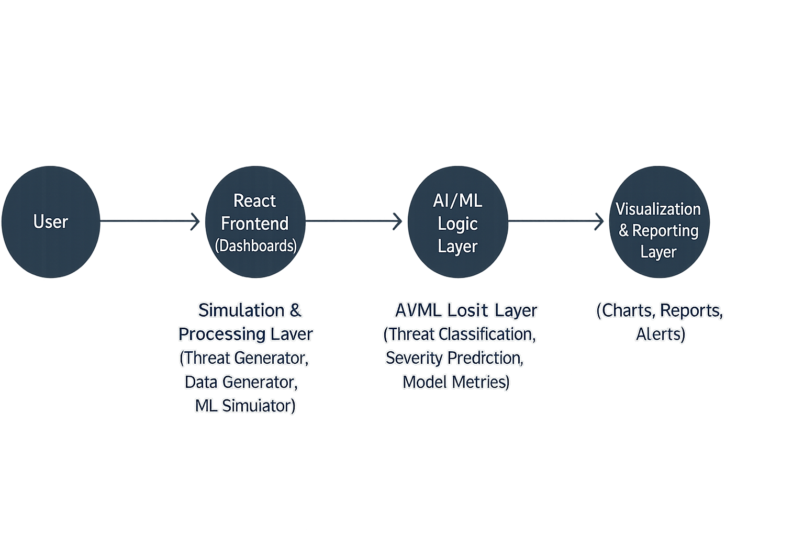

Technology Stack
&
System Architecture
Our AI & ML-based cybersecurity platform leverages modern technologies for comprehensive threat detection and analysis.
Frontend & Visualization
Data Science & ML
React - Frontend Hosting
Pandas & NumPy - Data manipulation
Render-Deployment
Scikit-learn - ML algorithms
Joblib - Parallel computing & LightGBM - Gradient Boosting Framework
Database
AI & System
PostgreSQL - Production environment
Gemini API Powered - Security Helper
VS Code - Local development
Architecture: Built with React
enabling real-time threat analysis and prediction
6 / 12
Notes:
6

Slide 7








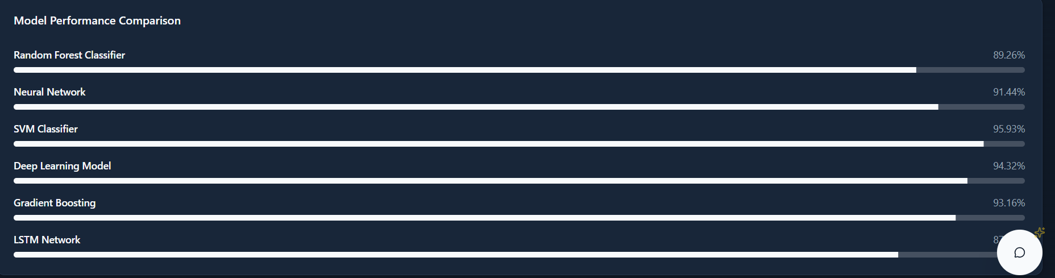
AI/ML Model
Performance
Our cybersecurity platform leverages machine learning to classify network traffic as benign or malicious.
Random Forest Classifier
Logistic Regression
An ensemble learning method that operates multiple decision trees for improved accuracy.
A statistical model that predicts traffic as benign or malicious based on learned patterns.
Robust against overfitting
Fast training and prediction
Classification Task
Key Metrics
Models classify network traffic as 'Benign' or 'Malicious' (e.g., 'DDoS', 'Keylogger').
Accuracy: High classification precision
Precision: Reliable positive predictions
Recall: Comprehensive threat detection
F1-Score: Balanced precision-recall
7 / 12
Notes:
7

Slide 8













Revolutionary
Advantages & Impact
Our AI-powered platform transforms cybersecurity operations, enabling analysts to move from reactive defense to proactive threat hunting.
Traditional Security
AI Transformation
AI-Powered Security
Reactive, manual analysis
Proactive, intelligent defense
Power User Experience
Moving to Proactive Defense
The AI and UI do the heavy lifting, enabling non-data scientists to find insights without complex queries.
Instead of just logging threats, our system predicts them, transforming security from reactive to proactive.
Unified Security Platform
AI-Powered Insights
Single tool for monitoring, investigation, and training—no more switching between 5 different apps.
The 'Security Helper' chatbot provides immediate, simple explanations for complex threats. Analysts can ask 'What does this mean?' or 'How do I fix this?' to get scannable guidance.
Impact: Transforming raw security data into actionable intelligence,
empowering security teams to act proactively
8 / 12
Notes:
8

Slide 9
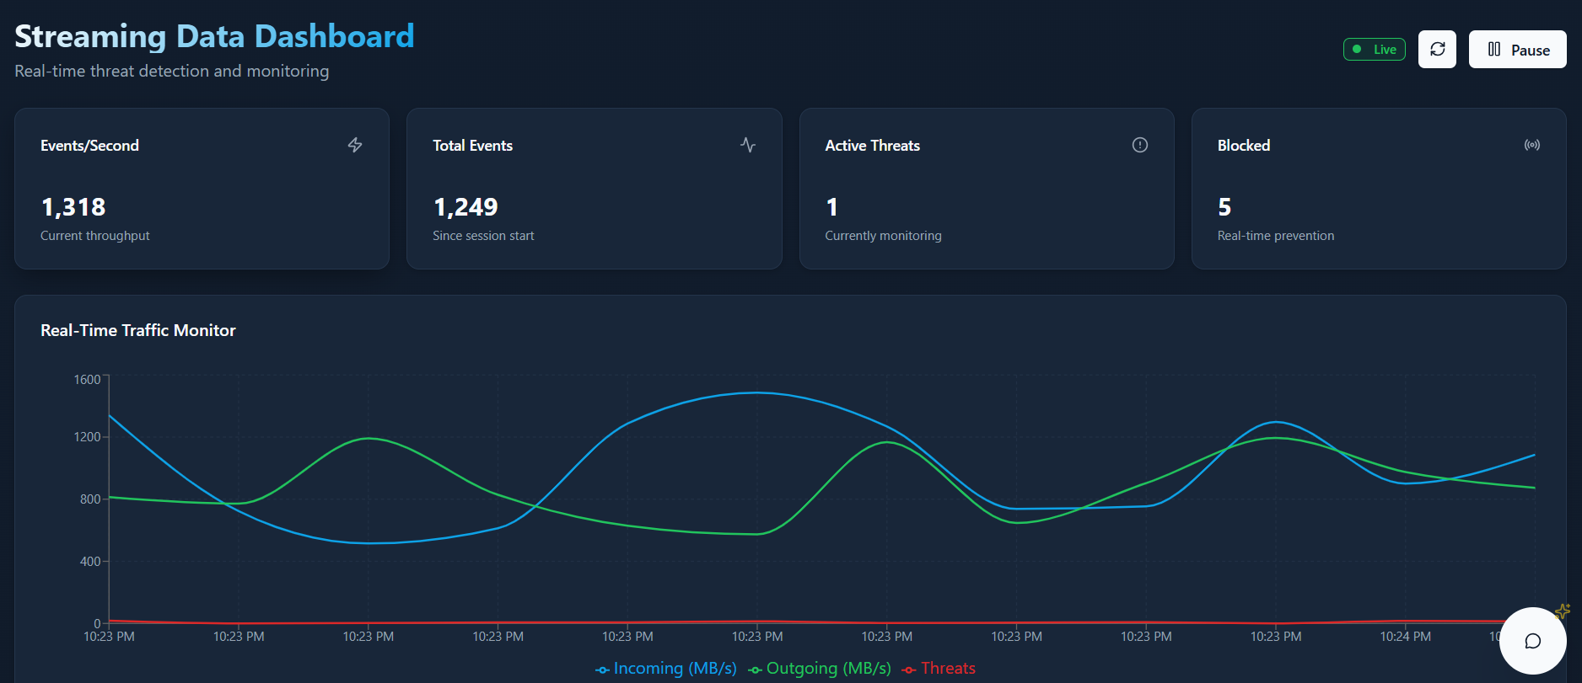


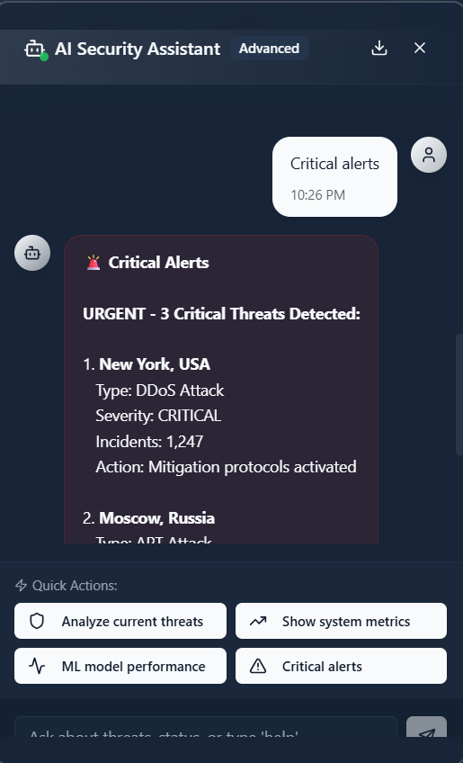



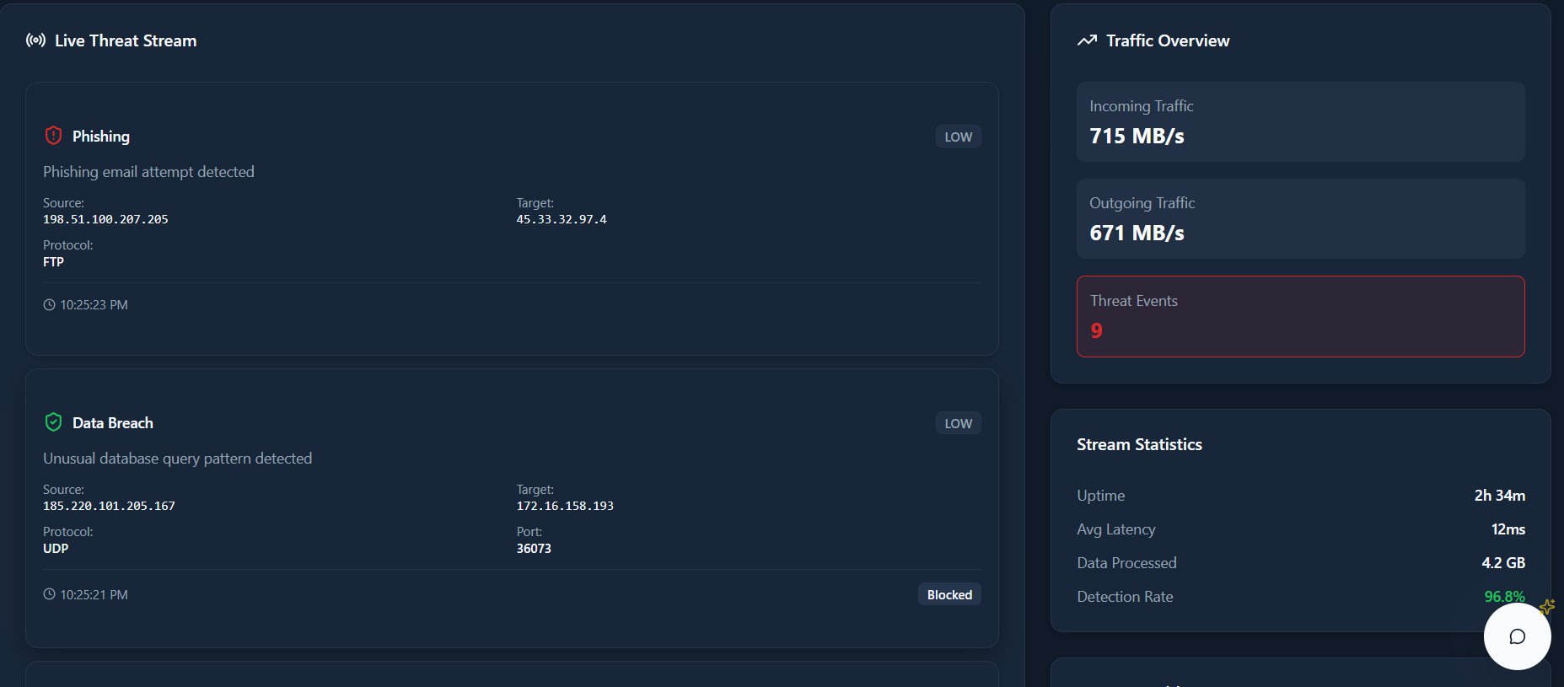

Project in Action:
Live Dashboard Demo
Security Helper" Chat Picture
Natural Language
Data Synthesis
Real-time Insights
Zero-Latency Awareness
Key Benefit: Real-time analysis provides a simple, color-coded threat level, a 'Risk Over Time' forecast, and an AI-powered helper to explain it all.
9 / 12
Notes:
9

Slide 10




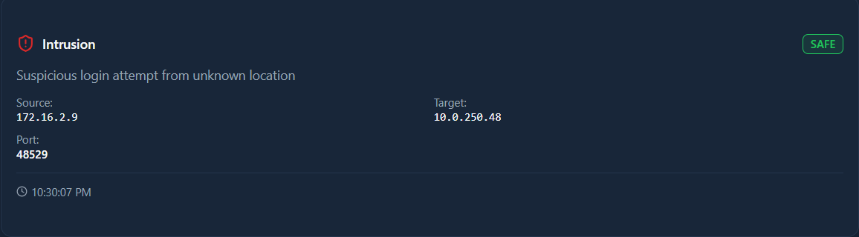

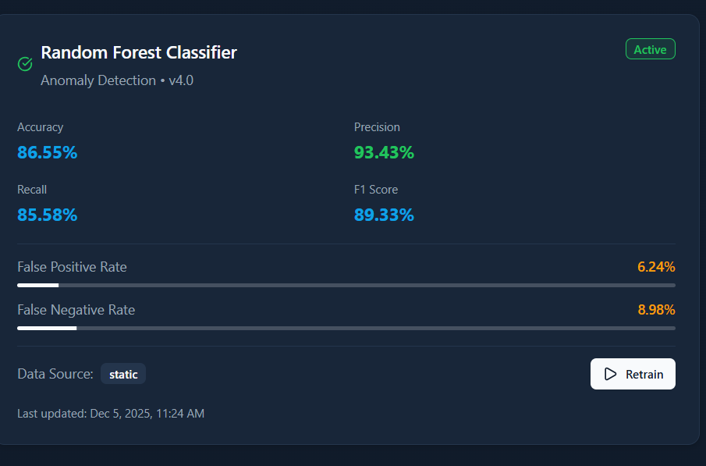
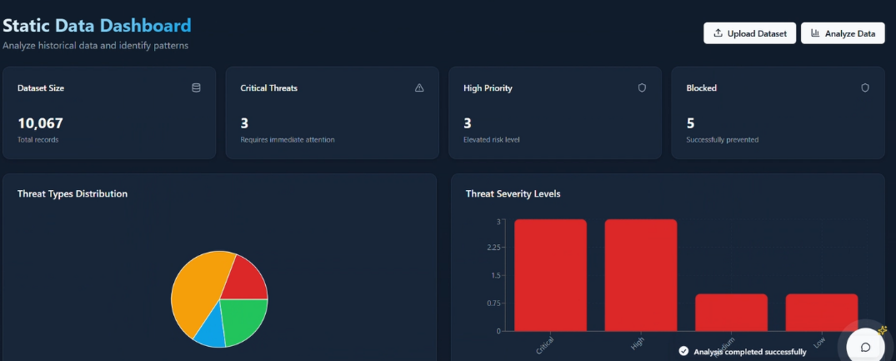

Project in Action:
Analysis & Training Features
Experience the platform's practical capabilities for threat analysis and model adaptation.
API & Website Scanning
Offline Analysis
Advanced Filtering & Trends
Real-time threat intelligence for IP addresses.
Upload historical data for comprehensive analysis.
Retrain models with new data to improve detection.
threat_data.csv
Risk Level:
MODERATE
Scans against VirusTotal & AbuseIPDB
Instant risk assessment
Admin panel for model retraining
Adapts to new threat patterns
Upload .csv files for analysis
Interactive geo-threat map
Key Benefit: System adaptability through continuous learning and human-in-the-loop validation
10 / 12
Notes:
10

Slide 11

















Challenges &
Future Roadmap
Current Challenges
Future Enhancements
API Integration
Real-time WebSocket Connections
Integrating and normalizing data from multiple, asynchronous third-party APIs (VirusTotal) into one seamless UI.
Enables instant bidirectional data updates for live Threat monitoring.
Backend Optimization
Email notifications for critical threads
Optimizing the backend to handle large offline dataset uploads without timing out.
Automatically alerts security teams whenever a high-severity threat is detected.
Data Consistency
Advanced Filtering and Search
Ensuring consistent data formatting and reliability across different security tools and threat intelligence sources.
Provides powerful data filters to quickly locate specific threats,events,or patterns.
Development Timeline
Current
S1
M1
L1
Integration
Auth & RBAC
Deep Learning
Alerting
11 / 12
Notes:
11

Slide 12








Conclusion & Impact
Our integrated AI-driven cybersecurity platform successfully transforms raw security data into actionable intelligence, empowering security teams to operate proactively.
Enhanced Protection
AI-Driven Intelligence
Proactive Security
Our platform combines real-time monitoring with powerful predictive ML and interactive analysis tools to create a comprehensive defense ecosystem.
Our platform provides AI-driven reports and a 'Security Helper' to transform complex security data into simple, actionable intelligence.
Moving from reactive defense to proactive threat hunting, our platform enables security teams to stay ahead of evolving threats.
Integrated
Real-time
Adaptive
Unified platform for monitoring, investigation, and training
Live threat feeds and alert panel for immediate response
Custom ML models that learn and improve over time
Thank You
12 / 12
Notes:
12

